Slide 1

Data Science 101
WTF is it and What do I need to know?

Slide 2


What is it?

Slide 3
Data to Insights
Data science is an interdisciplinary field that seeks to extract knowledge or insights from data (big data, structured or unstructured) which is typically thought of as an extension of data analysis

Slide 4
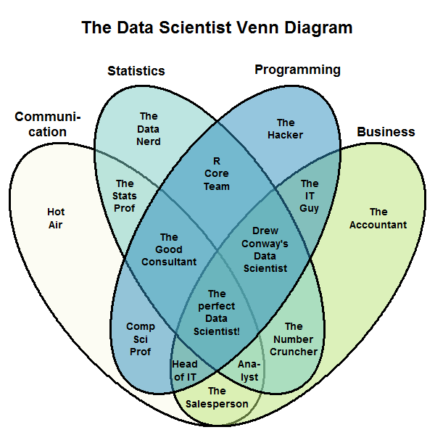
4 Pillars
Communication
Business/ Domain
Maths/Stats
Programming

Slide 5
“Data Science is what Data Scientists do”
- some tautological IBM data scientist

Slide 6
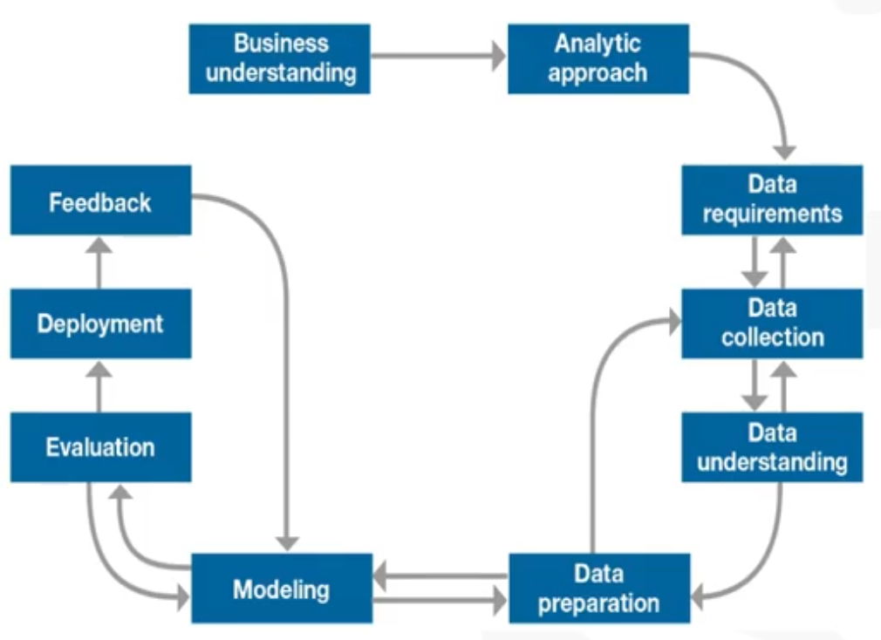
What does it look like?
Methodology
Tools

Slide 7
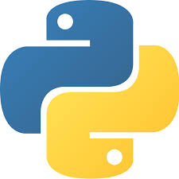

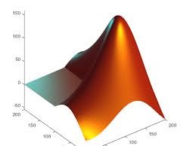

Python
Super accessible
General purpose computing language
Heaps of support and libraries
Current Data Science royalty alongside R
Dethroned Matlab and MathCAD

Slide 8


Anaconda
Supports multiple IDEs in a single FREE package
Bundles in the most popular and supported R and Python Libraries (including multiple Data Science & Machine Learning)
Supports Python, R and other programming languages
Nice customizable interface to open a wide variety of IDEs

Slide 9
Schedule
 | Title | Description | Exercise
1 | Python 101 | Intro to syntax and core concepts | Python workbook
2 | Data Analysis | Analysis libraries (numpy and pandas) | Vehicles classification
3 | Databases | DB storage and SQL | Build own database
4 | Visualisation | Sexy graphs, charts, and wordclouds | Colourful visualisation
5 | Machine Learning | Simple models | Regression & Decision Trees?
6 | Machine Learning | Complex models | Visual recognition
7 | Watson Integration | Integrating with Watson cloud services | Watson labs

